Slide 1
Agentic
LLMs
Micro-Internship 2024
Data Reply

Slide 2
01
What is an agent?
Notes:
What is Generative AI
Systems that are trained on existing data to create new content by finding patterns
Includes text, audio, image, video
What are LLMs
Subset of Gen AI that generates text
What are Agents (Agentic AI, Agentic workflows etc)
systems or workflows that operate autonomously – make decisions and adapt to changing environments
What are the leading Gen AI frameworks (Langchain)
Langchain is a framework to integrate LLMs into applications
Roadmap of gen ai 2025?

Slide 3
LLM vs Agent
Acts as a passive system that generates responses purely based on input prompts.
It does not perform any external actions or interact with external systems.
Limited to producing text-based responses. If external interaction is required the user must do it manually.
Example: Writing essays, explaining concepts, summarizing text.
Can interact with tools, APIs, or external environments to gather information, make decisions, and take actions.
Has autonomy to decide what to do next based on intermediate reasoning or feedback loops.
Useful for complex problem-solving requiring external information or interaction with dynamic environments.

Slide 4
02
Industry research

Slide 5
Industry research
Retail
Automated Replenishment
Personalized Recommendations
Manufacturing
Aftermarket Services - handle customer inquiries
Sales and Marketing - content creation, social media
Finance
Automated Trading - optimise investment portfolios
Automated Underwriting - make lending decisions

Slide 6
Product Sourcing and Procurement
Automated replenishment
Supplier selection
Negotiate prices, terms, and delivery schedules.
Website functionality, user experience
Manage services like click-and-collect and returns
Marketing and Sales
Customer Service and Support
Answering questions, providing product information
Handling returns, exchanges, and warranties
Maintain accurate financial records, including sales revenue, taxes
Ensure adherence to laws, including tax regulations and health and safety requirements.
Finance and Administration
Value Chains - retail
Series of activities or processes that create value for a retailer by delivering products or services to consumers
Notes:
the replenishment process by generating purchase orders based on real-time demand forecasts and inventory levels

Slide 7
Problem and statistics
Stockouts
A large quantitative study measured the performance of manual and automatic replenishment processes in a sample of 85 stores and 95 products of a major retail chain in Serbia. The study concluded that utilization of an automatic replenishment system can reduce stock-outs for the retail chains up to 60%. Specifically, when ordered through an automatic replenishment system, fast-selling products recorded 40% greater availability, products on promotion 48% higher availability, and products in a high-density retail stores 59% higher availability.
A global survey revealed that only 12% of retailers utilize machine learning technologies in their replenishment activities.
Overstocks - wastes money
Backorders - when customer orders product that is waiting to be restocked
reduces customer satisfaction, miss out on profits
Notes:
the replenishment process by generating purchase orders based on real-time demand forecasts and inventory levels

Slide 8
03
Agent development

Slide 9
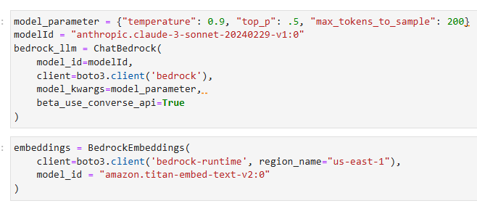
Agent setup

Slide 10
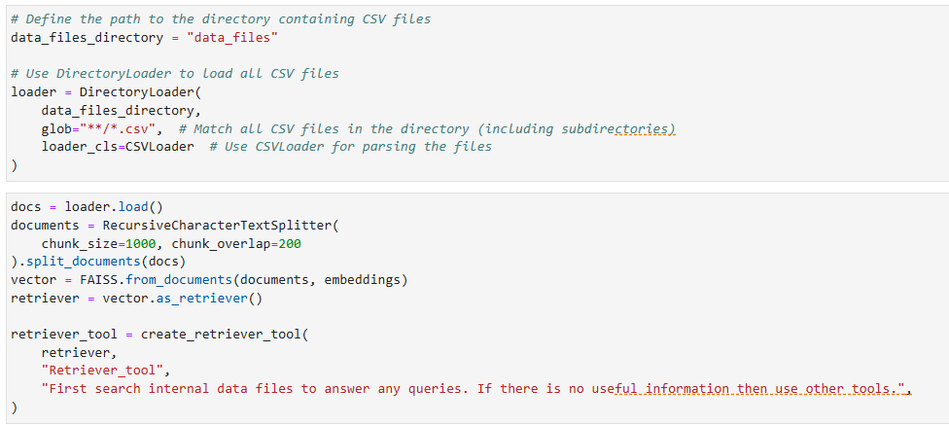
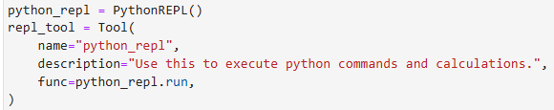
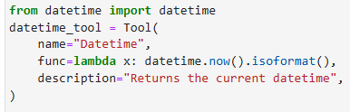
Tools
Retriever
Tavily
Maths - Python REPL
Wikipedia
Date time

Slide 11
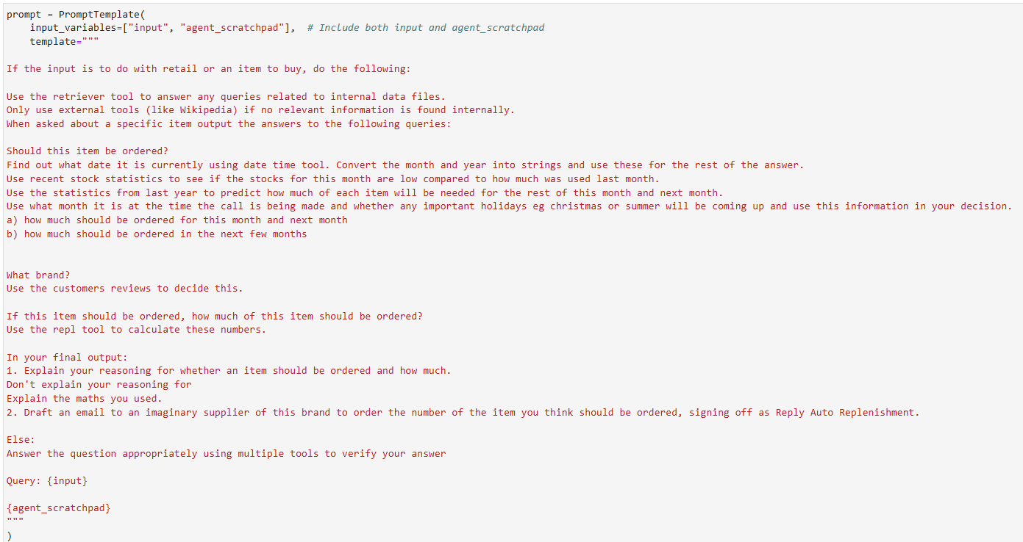
Prompt engineering

Slide 12

Calling our agent
Notes:
Mention verbose

Slide 13
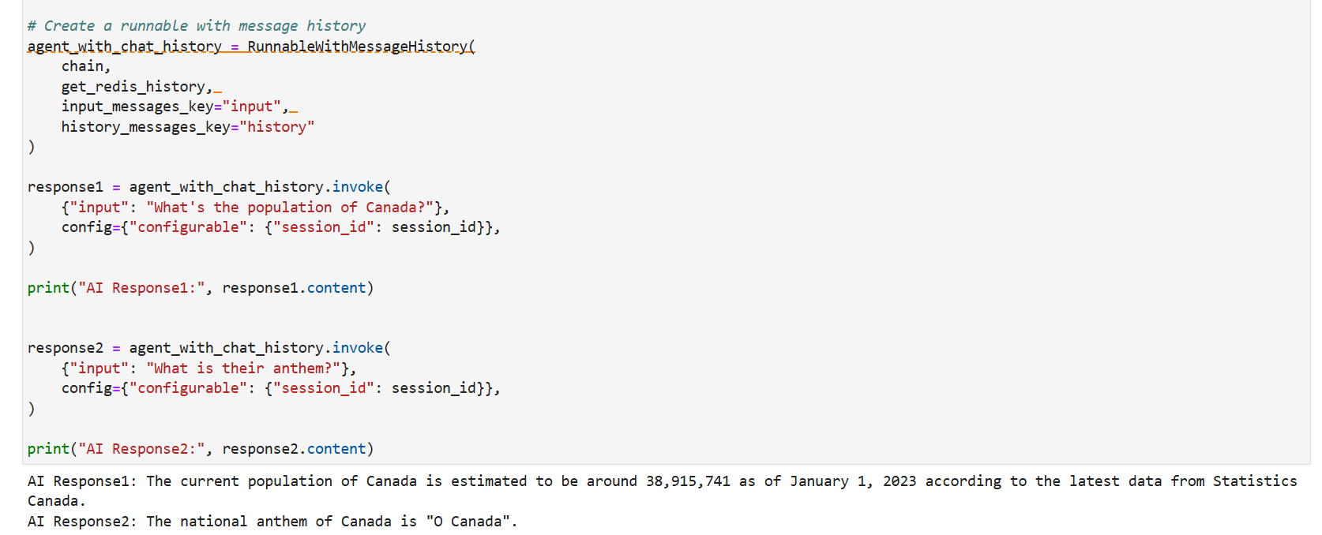
Memory

Slide 14
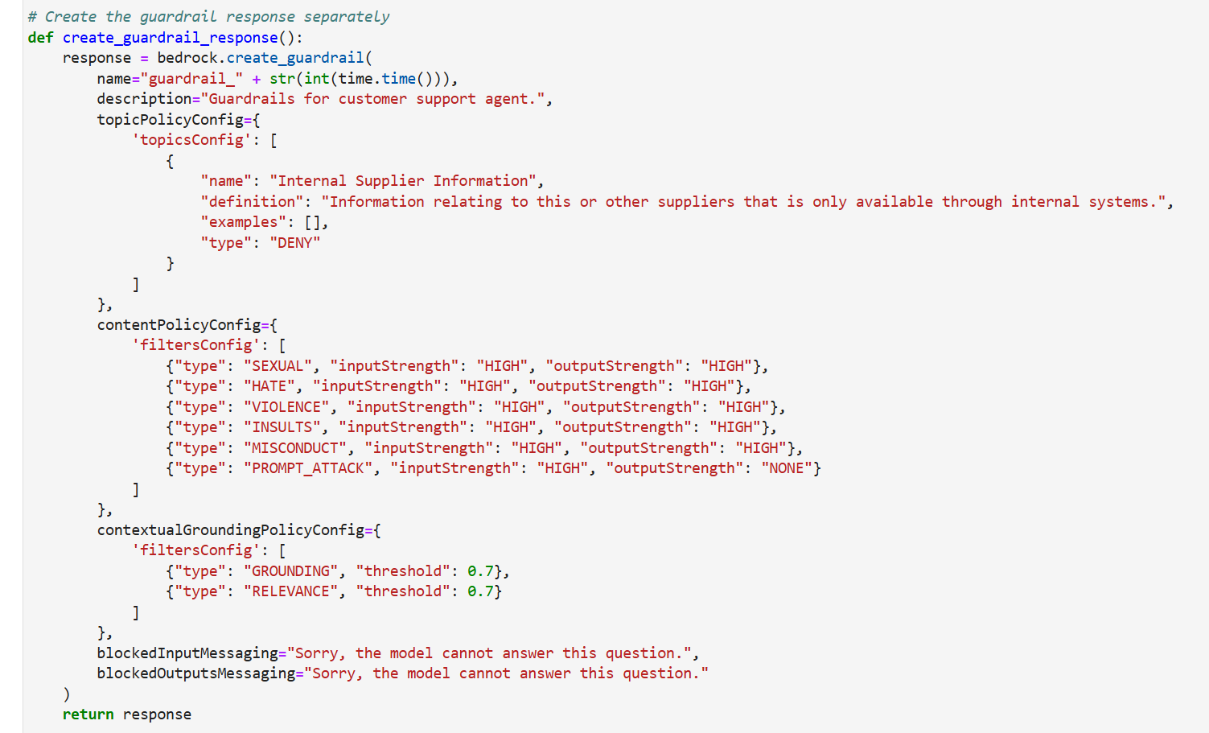
Guardrails

Slide 15
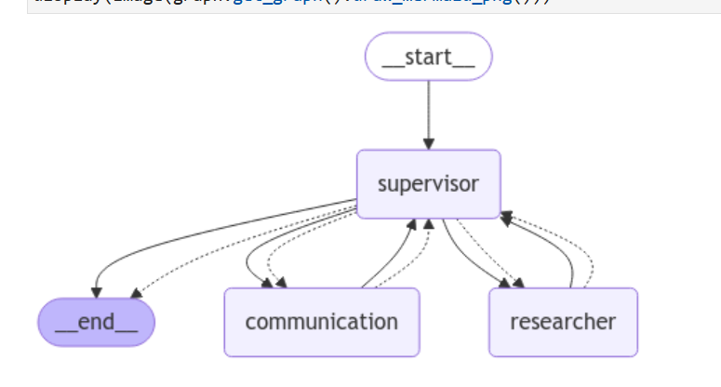
Multi-agent system
(show diagram)

Slide 16
04
Final agent

Slide 17
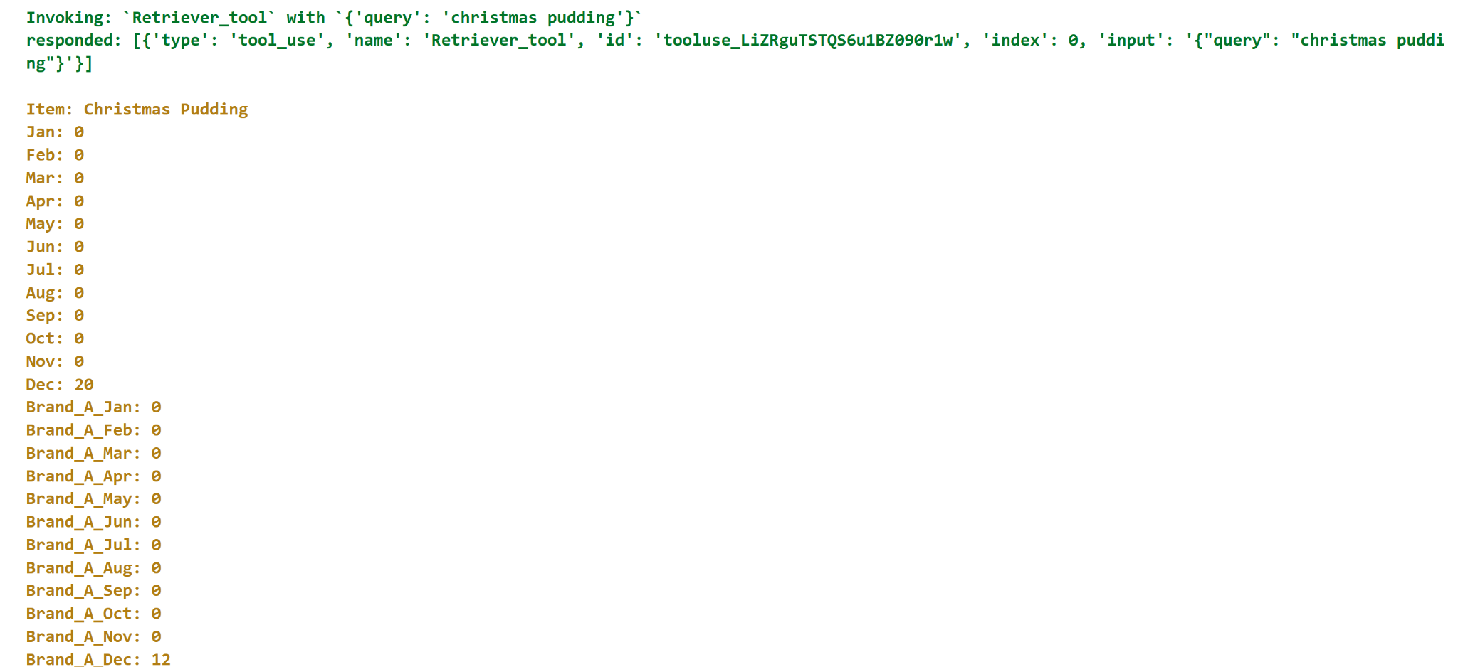
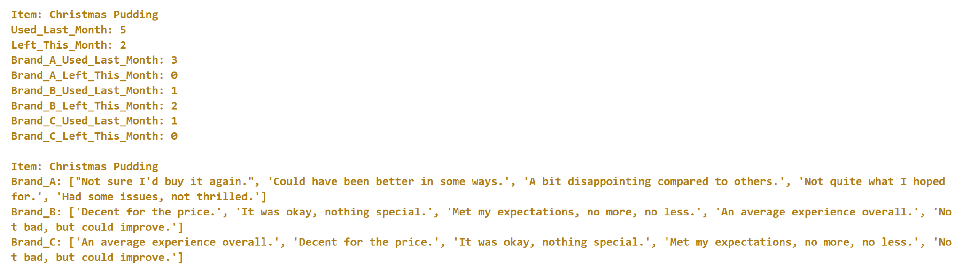
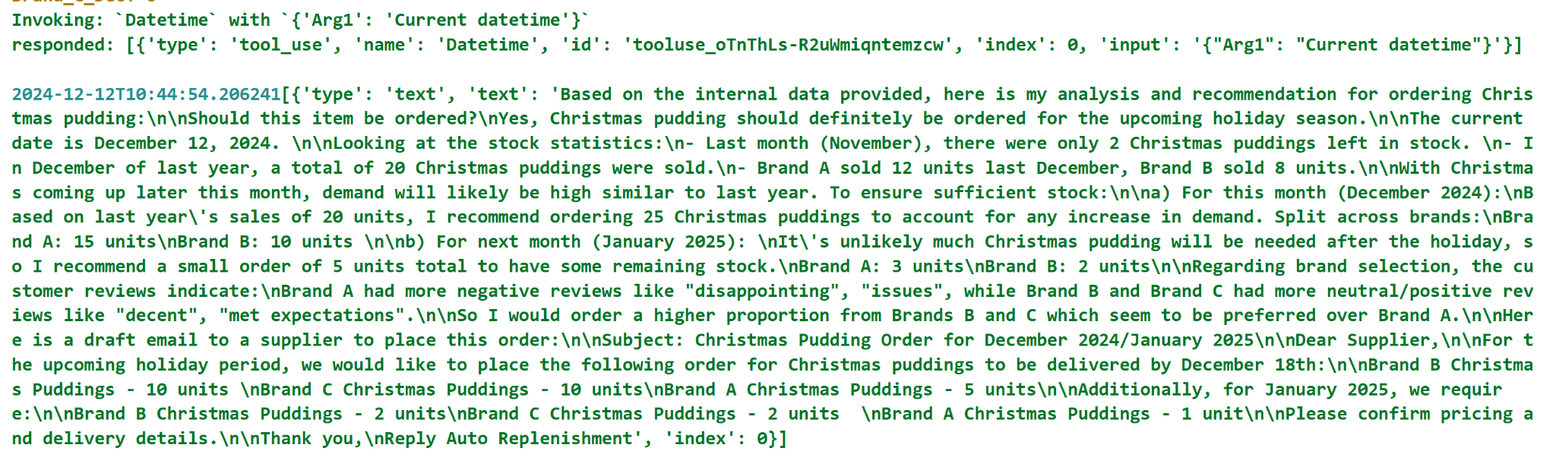
ReAct
Thought
Action
Observation
Example - replenishment of Christmas pudding

Slide 18
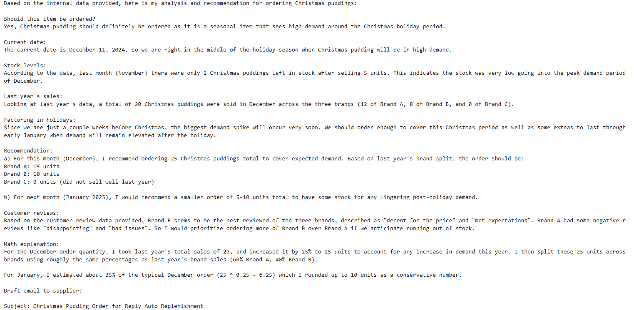
Example response - christmas pudding

Slide 19
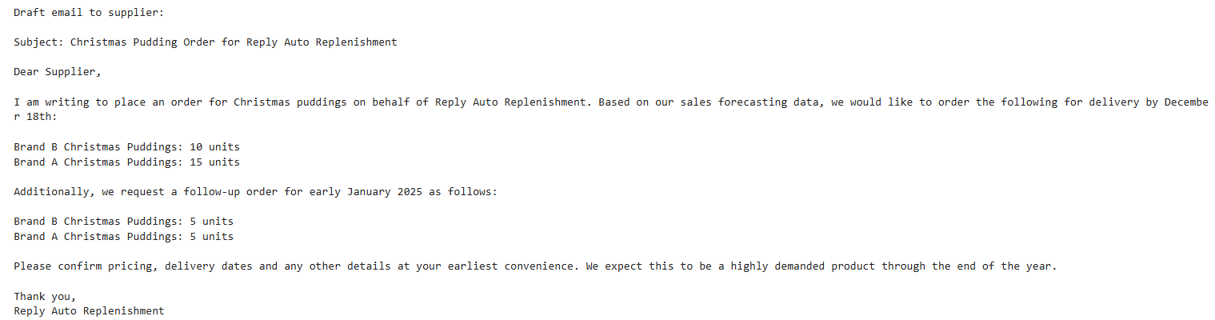
Email draft
Notes:
If irl would actually send email autonomously instead of just creating a draft

Slide 20
05
Challenges and lessons

Slide 21
Challenges
Brainstorming ideas - industry research
OpenAI vs Bedrock
Deprecated features and beta features
Coding own tools
Simulating data / reviews
Memory
Guardrails
Multi-agent system

Slide 22
What we’ve learnt
Uses of an agent in industry
How to set up an agent
Learning on the job
Debugging
Perseverance and creativity
Collaboration
Notes:
-Uses of an agent and how to set one up
-Debugging
-Learning on the job
-Time management
-Teamwork and collaboration
-Persistence and patience

Slide 23
Questions?

Slide 24
Appendix

Slide 25
Example responses - suncream
Based on the internal data provided, here is my analysis and recommendation for ordering suncream:
1. The data shows that suncream sales peak in the summer months of June, July and August. With the current date being December 11th, we are heading into the winter season where suncream demand will be very low.
2. Looking at last month's (November) data:
- Total suncream units sold: 20
- Units left in stock this month: 5
3. For the brand breakdown last month:
- Brand A: 6 units sold, 1 unit left
- Brand B: 13 units sold, 3 units left
- Brand C: 1 unit sold, 1 unit left
4. Reviewing the customer reviews:
- Brand A has the most positive reviews
- Brand B has average/decent reviews
- Brand C has more negative reviews
5. Based on the low demand in winter, the remaining stock levels, and the better customer reviews for Brand A, I would recommend:
a) For this month (December): Do not order any additional suncream units. The 5 units left should cover any limited demand.
b) For next month (January): Order 50 units of Brand A suncream to have stock ready for when demand starts picking up in spring/summer.
6. Looking further ahead, order quantities should increase for the key summer months based on historical data:
- April: Order 100 units (60 Brand A, 40 Brand B)
- May: Order 150 units (100 Brand A, 50 Brand B)
- June: Order 250 units (150 Brand A, 100 Brand B)
The math behind these recommendations:
- December & January orders based on 5 units left + typical low winter demand
- Spring/summer orders calculated as 125% of previous year's demand for those months, favoring Brand A due to better reviews

Slide 26
Email drafts - 1
Here is a draft email to a Brand A suncream supplier:
Subject: Suncream Order for January
Dear Supplier,
I am writing to place an order for 50 units of your Brand A suncream for delivery in early January. Based on our sales forecasting data, we anticipate demand will start increasing next month as we head into the spring season.
Our customers have provided excellent reviews for your Brand A suncream compared to other brands we carry. We would like to ensure we have enough inventory of this top-performing product heading into the busy spring and summer months.
Please confirm pricing and delivery timeline for this 50 unit order to be shipped in early January. We plan to place further orders ramping up quantities for April through June in preparation for peak suncream demand.
Thank you,
Reply Auto Replenishment

Slide 27
What is RAG?
What is RAG
Retrieval-Augmented Generation - process of optimisation through referencing external data outside of the training set
Cost-effective
Up-to-date
Provides citations
More accurate - tackles hallucination by redirecting LLM to retrieve information from trusted sources.

Slide 28
More statistics
Digital Automation in Replenishment: A global survey revealed that only 8% of retailers have implemented real-time automated processes for demand planning and forecasting. Additionally, 12% utilize machine learning technologies in their replenishment activities. Statista
Impact of Stockouts: Stockouts, or out-of-stock events, significantly affect retailers' profitability. Studies indicate that the global inventory distortion due to out-of-stock grocery products was valued at over $500 billion in 2020. Statista
Causes of Stockouts: Approximately 70-90% of stockouts result from defective shelf replenishment practices, while the remaining 10-30% stem from upstream supply chain issues, such as supplier shortages. Wikipedia, McKinnon, A.C., Mendes, D. and Nabateh, M. (2007), "In-store logistics: an analysis of on-shelf availability and stockout response for three product groups", International Journal of Logistics: Research and Applications, Vol. 10 No. 3, pp. 251-68.
Shrinkage Rates: Shrinkage, which includes losses from theft, administrative errors, and damaged goods, poses a significant challenge to retail replenishment efficiency. In 2008, U.S. retailers experienced an average shrinkage rate of 1.52% of sales, translating to substantial financial losses. Wikipedia
Gross Margin Return on Inventory Investment (GMROII): This metric assesses the profitability of inventory. A GMROII above 3.0 is considered favorable for retailers, indicating a good balance between sales, margin, and inventory cost. Wikipedia
Inventory Inaccuracies: Inaccurate inventory records can cost retailers approximately 4% in annual sales. Detecting and correcting these inaccuracies manually is often cost-prohibitive, and existing algorithmic solutions may fall short in dynamic retail environments. arXiv
Shrinkage Rates: Shrinkage, encompassing losses from theft, administrative errors, and damaged goods, poses a significant challenge to retail replenishment efficiency. In 2008, U.S. retailers experienced an average shrinkage rate of 1.52% of sales, translating to substantial financial losses. Wikipedia
Stockouts: Stockouts, or out-of-stock events, significantly affect retailers' profitability. Studies indicate that the global inventory distortion due to out-of-stock grocery products was valued at over $500 billion in 2020. Wikipedia
Food Waste in Retail: Retail stores often discard large quantities of food items that have reached their best-before, sell-by, or use-by dates, contributing to significant food waste. In the United States, some of the estimated six billion pounds of produce wasted each year are discarded because of appearance standards. Wikipedia

Slide 29
FOR A MEDIUM TO LARGE RETAIL COMPANY
Potential Costs with LLM Replacement:
LLM deployment per branch: Estimated initial setup (hardware, software, and integration) cost of £50,000 per branch. 500×£50,000=£25,000,000 500×£50,000=£25,000,000500 x £50,000 = £25,000,000
Ongoing maintenance costs: Estimated at 10% of the setup cost annually. 10%×£25,000,000=£2,500,000 annually. 10%×£25,000,000=£2,500,000 annually.10\% x £25,000,000 = £2,500,000 annually
First-Year Costs:
Initial setup: £25,000,000+Ongoing maintenance: £2,500,000=£27,500,000
Net Savings in First Year:
Current management costs: £113,750,000−£27,500,000=£86,250,000
Assumptions
Number of branches per company: 500 (a medium-to-large UK retail chain like Sainsbury's or Tesco).
Average management staff per branch: 7 (including store managers, assistant managers, and department heads).
Average salary per management staff: £32,500 per year.
Total annual salary costs per branch: 7×£32,500=£227,500 7×£32,500=£227,5007 x £32,500 = £227,500
Total salary costs for management across all branches: 500×£227,500=£113,750,000 500×£227,500=£113,750,000500 x £227,500 = £113,750,000
Net Savings in Subsequent Years:
Annual salary savings: £113,750,000−Maintenance: £2,500,000=£111,250,000

